Slide 1
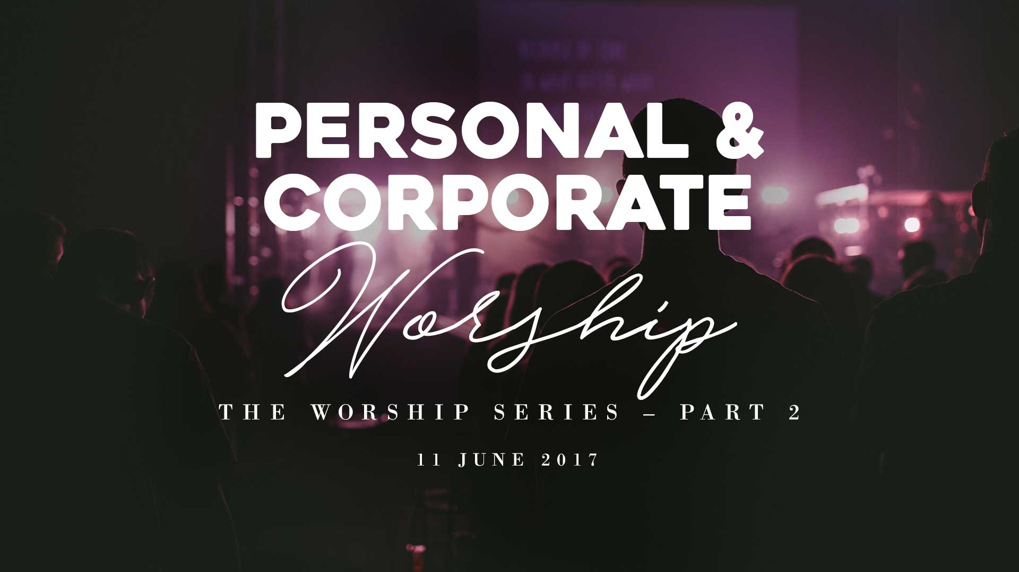

Slide 2
Last Sunday: Part 1 – Understanding Worship
Worship - Recognition |Reverence | Communion | Response.
True worshippers & spirit and truth worship.
Worship – Transformed, God’s presence, Empowered
Worship. Especially in difficult times.

Slide 3
Worship
Offering up of Sacrifices to God

Slide 4
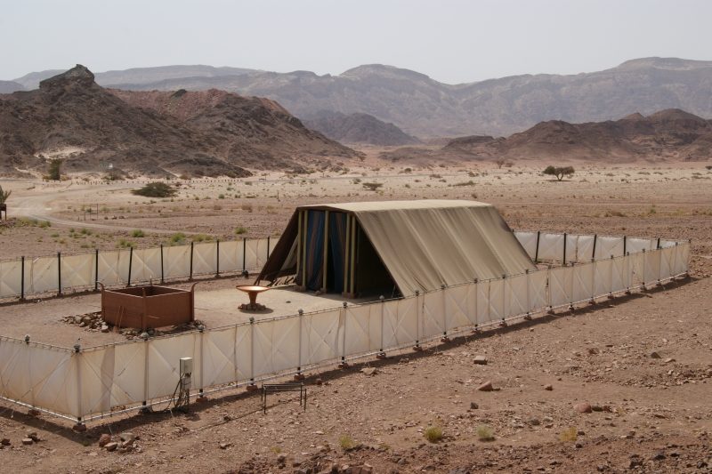
The Tabernacle

Slide 5
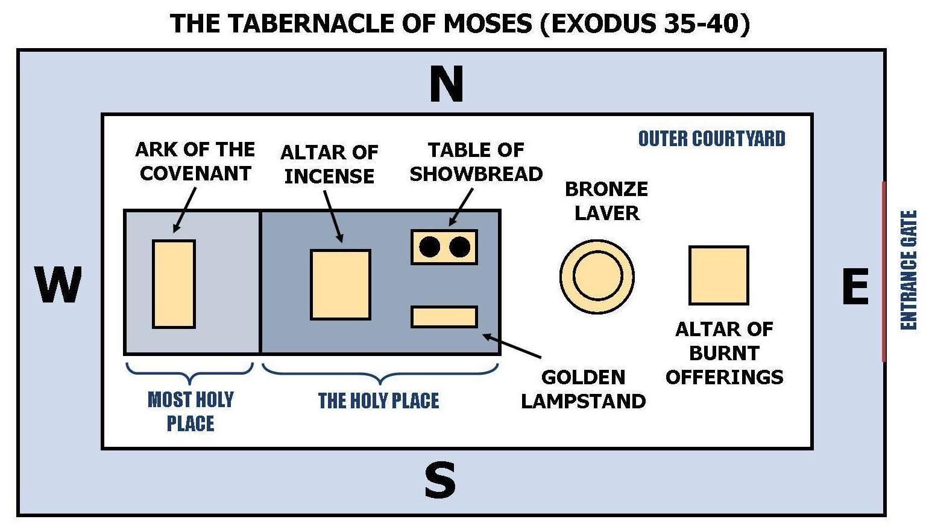
The Tabernacle

Slide 6
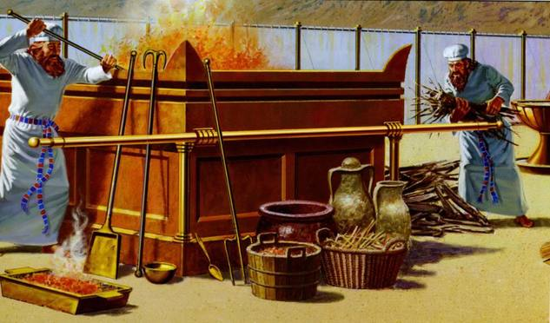
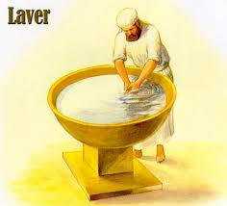
The Tabernacle
The Outer Court
The Altar of Sacrifice The Bronze Laver

Slide 7
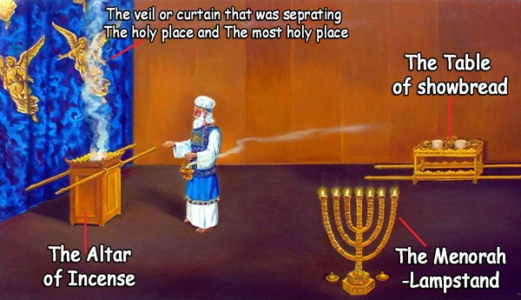
The Tabernacle
The Holy Place

Slide 8
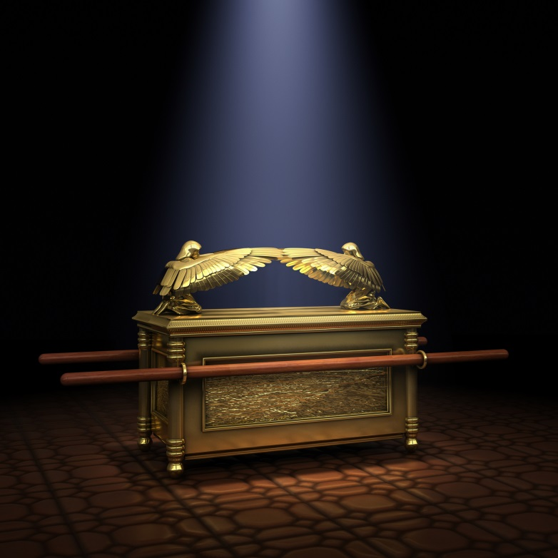
The Tabernacle
The Holy of Holies
The Ark of the Covenant

Slide 9
Jesus Christ - The Perfect Sacrifice
Hebrews 9:9, 11-12
⁹ It was symbolic for the present time in which both gifts and sacrifices are offered which cannot make him who performed the service perfect in regard to the conscience
¹¹ But Christ came as High Priest of the good things to come, with the greater and more perfect tabernacle not made with hands, that is, not of this creation. ¹² Not with the blood of goats and calves, but with His own blood He entered the Most Holy Place once for all, having obtained eternal redemption.

Slide 10
Jesus Christ - The Perfect Sacrifice
Hebrews 10:11-12
¹¹ And every priest stands ministering daily and offering repeatedly the same sacrifices, which can never take away sins. ¹² But this Man, after He had offered one sacrifice for sins forever, sat down at the right hand of God,

Slide 11
Jesus Christ - The Perfect Sacrifice
Hebrews 10:19-22
¹⁹ Therefore, brethren, having boldness to enter the Holiest by the blood of Jesus, ²⁰ by a new and living way which He consecrated for us, through the veil, that is, His flesh, ²¹ and having a High Priest over the house of God, ²² let us draw near with a true heart in full assurance of faith, having our hearts sprinkled from an evil conscience and our bodies washed with pure water.

Slide 12
Personal Worship
1) Draw near to God intentionally
Hebrews 10:19-22
¹⁹ Therefore, brethren, having boldness to enter the Holiest by the blood of Jesus, ²⁰ by a new and living way which He consecrated for us, through the veil, that is, His flesh, ²¹ and having a High Priest over the house of God, ²² let us draw near with a true heart in full assurance of faith, having our hearts sprinkled from an evil conscience and our bodies washed with pure water.

Slide 13
Personal Worship
2) Give thanks and praise in spoken words, in song (spontaneous songs, known songs, sing along to a track)

Slide 14
Personal Worship
3) Read or Sing aloud the Word
Psalm 36:5-7
⁵ Your mercy, O Lord, is in the heavens; Your faithfulness reaches to the clouds. ⁶ Your righteousness is like the great mountains; Your judgments are a great deep; O Lord, You preserve man and beast.⁷ How precious is Your lovingkindness, O God! Therefore the children of men put their trust under the shadow of Your wings.

Slide 15
Personal Worship
4) Sing & Speak in tongues

Slide 16
Priests unto God
1 Peter 2:5
⁵ you also, as living stones, are being built up a spiritual house, a holy priesthood, to offer up spiritual sacrifices acceptable to God through Jesus Christ.

Slide 17
Priests unto God
Hebrews 13:15
¹⁵ Therefore by Him let us continually offer the sacrifice of praise to God, that is, the fruit of our lips, giving thanks to His name.

Slide 18
Praise
What is it?
To commend, applaud, to express approval or admiration

Slide 19
Praise
What is it?
Praise is the verbal declaration of adoration and thanksgiving for what God has done and for what He has promised to do.

Slide 20
Praise
What is it?
Praise is the spiritual sacrifice that we offer to God.

Slide 21
Praise
Sacrifice involves
Giving up something that I have a right to
Taking on something that I don’t have to
Death - comfort, self-pity, fleshly desires, pride.

Slide 22
Praise
In Hebrew
Yadah . Todah . Halal . Shabach . Tehillah . Barak . Zamar

Slide 23
Praise
Must be declared or displayed.
Psalm 66:8
⁸ Oh, bless our God, you peoples! And make the voice of His praise to be heard,
Meditation or contemplation is not praise.

Slide 24
Expressions of Praise & Worship
1) Proclamation
Psalm 26:7
That I may proclaim with the voice of thanksgiving, And tell of all Your wondrous works.

Slide 25
Expressions of Praise & Worship
2) Singing
Psalm 47:6
Sing praises to God, sing praises! Sing praises to our King, sing praises!

Slide 26
Expressions of Praise & Worship
3) Clapping
Psalm 47:1
Oh, clap your hands, all you peoples! Shout to God with the voice of triumph!

Slide 27
Expressions of Praise & Worship
4) Shouting
Psalm 66:1
Make a joyful shout to God, all the earth!

Slide 28
Expressions of Praise & Worship
5) Lifting of hands
Psalm 134:2
Lift up your hands in the sanctuary, And bless the Lord.

Slide 29
Expressions of Praise & Worship
6) Playing musical instruments
Psalm 33:2-3
² Praise the Lord with the harp; Make melody to Him with an instrument of ten strings. ³ Sing to Him a new song; Play skillfully with a shout of joy.

Slide 30
Expressions of Praise & Worship
7) Singing or Speaking in tongues
Acts 10:45-46
⁴⁵ And those of the circumcision who believed were astonished, as many as came with Peter, because the gift of the Holy Spirit had been poured out on the Gentiles also. ⁴⁶ For they heard them speak with tongues and magnify God.

Slide 31
Expressions of Praise & Worship
8) Standing
2 Chronicles 7:6
⁶ And the priests attended to their services; the Levites also with instruments of the music of the Lord, which King David had made to praise the Lord, saying, “For His mercy endures forever,” whenever David offered praise by their ministry. The priests sounded trumpets opposite them, while all Israel stood.

Slide 32
Expressions of Praise & Worship
9) Dancing
Psalm 149:2-3
² Let Israel rejoice in their Maker; Let the children of Zion be joyful in their King.³ Let them praise His name with the dance; Let them sing praises to Him with the timbrel and harp.

Slide 33
Expressions of Praise & Worship
10) Kneeling . Bowing . Prostrating
Psalm 95:6
⁶ Oh come, let us worship and bow down; Let us kneel before the Lord our Maker.

Slide 34
When we praise..
1) God inhabits our praise
Psalm 22:3
³ But You are holy, Enthroned in the praises of Israel.

Slide 35
When we praise..
2) There is divine deliverance
2 Chronicles 20:22
²² Now when they began to sing and to praise, the Lord set ambushes against the people of Ammon, Moab, and Mount Seir, who had come against Judah; and they were defeated.

Slide 36
When we praise..
3) The enemy is silenced & stopped
Psalm 8:2
² Out of the mouth of babes and nursing infants You have ordained strength, Because of Your enemies, That You may silence the enemy and the avenger.

Slide 37
When we praise..
4) Our hearts are prepared to receive from God
Hosea 10:11
¹¹ Ephraim is a trained heifer That loves to thresh grain; But I harnessed her fair neck, I will make Ephraim pull a plow. Judah shall plow; Jacob shall break his clods.”

Slide 38
When we Praise God together..
We minister to God
We become united
We learn and teach spiritual truth
Our hearts are prepared to receive His Word
We become uninhibited in our worship

Slide 39
Hindrances to Praise & Worship
Pride
Irreverence
‘Spectator-ism’
‘Sentimentalism’
Mere lip-service
Resisting change

Slide 40
Worshipping Him
Alone & Together
Let’s not trade one for the other!
Let’s go deeper and further than ever before!

